Slide 1
Visual Analytics with Power BI
- Pravin Khatake

Slide 2
Course Deliverables
This course will help you learn to visualize data using one of the most widely used tool – Power BI
Get data
Explore Data
Prepare Data
Visualize Data
Publish Reports
Learn DAX (Data Analysis Expressions) to create Measures in reports
Similarities and Differences in Tableau and Power BI
Resume and Interview questions
Visual Analytics with Power BI

Slide 3
Day 1
Get Data
Transform/Clean Data
Analyse Data
Report/Visualization
Large options for connecting to different data sources
Refresh data with every load or periodic refresh
Use data from different sources simultaneously
Applied steps
Rename table, columns
Column Headers, Data types
Null values, unique values
Split columns
Replace values
Model Relations
Fields, Visualization and Filter Pane
Geo location analysis
Measures and Calculated Columns
Charts – Fields and formatting
Text boxes
Sorting, Tooltips,
Drop downs
Drill up, Drill down
Visual interactions
Slicing, buttons
Hierarchy
Visual Analytics with Power BI

Slide 4
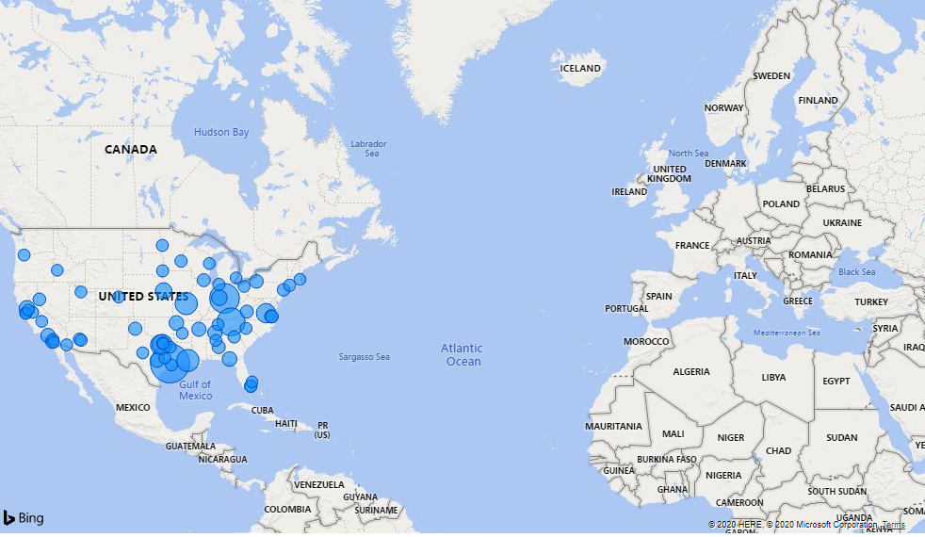
Challenge - 01
Instructions –
Data Set – SuperStore
Display sales for different cities on map
Size of the city marker should be proportional to the total sales in the city
Note that the data consists of cities only in US and map should display accordingly. (https://www.latlong.net/category/cities-236-15.html)
Desired Report
Visual Analytics with Power BI

Slide 5
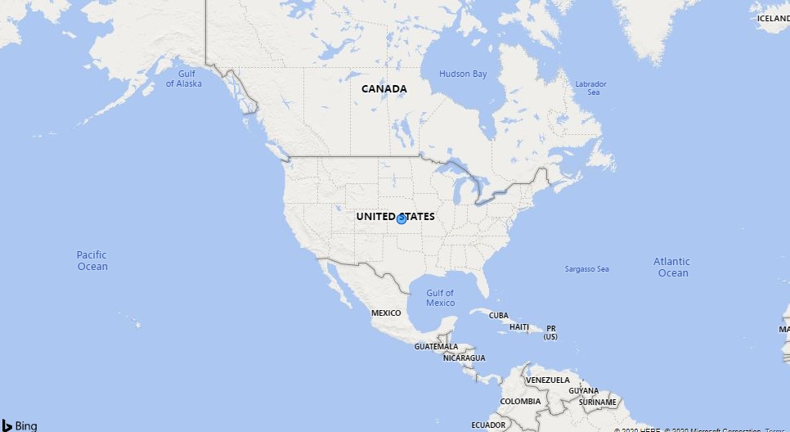
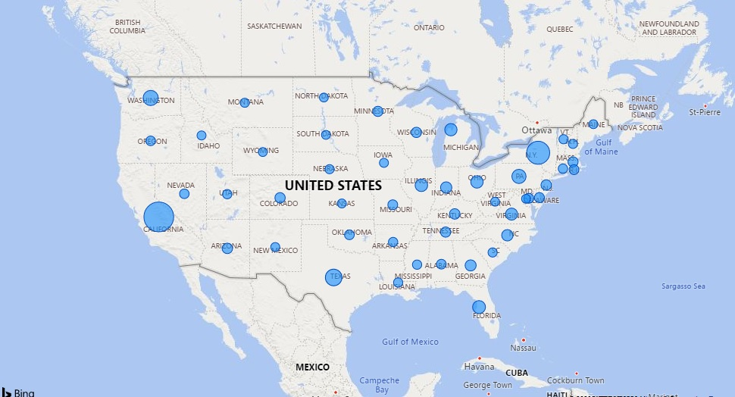
Challenge - 02
Instructions –
Data Set – SuperStore
Display sales for country on map. There should be drill down and drill up option to view state and city sales
Desired Report
Visual Analytics with Power BI

Slide 6
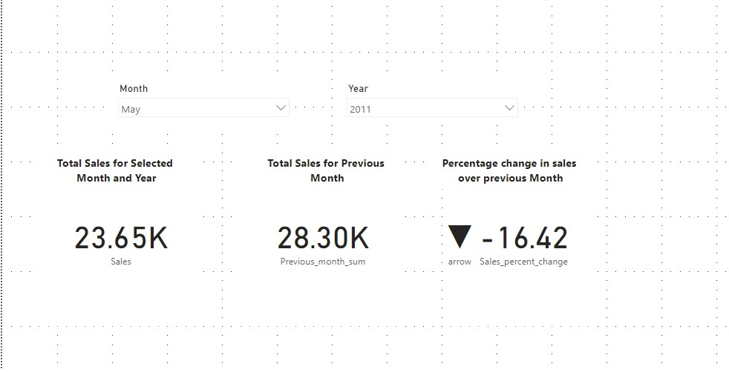
Challenge - 03
Instructions –
Data Set – SuperStore
A Select Month parameter to choose the month
A Select Year parameter to choose the year
Total Sales for that selected month and year
The delta from the previous month expressed as a KPI
hint: the downward arrow is a UTF-8 character and not a shape or image
Desired Report
Visual Analytics with Power BI
Notes:
Previous_month_sum = CALCULATE(sum(Orders[Sales]), PREVIOUSMONTH(Orders[Order Date].[Date]))
Sales_percent_change = (SUM(Orders[Sales])-[Previous_month_sum])/[Previous_month_sum]
arrow = SWITCH(True(), [Sales_percent_change]<0, UNICHAR(9660), UNICHAR(9650))

Slide 7
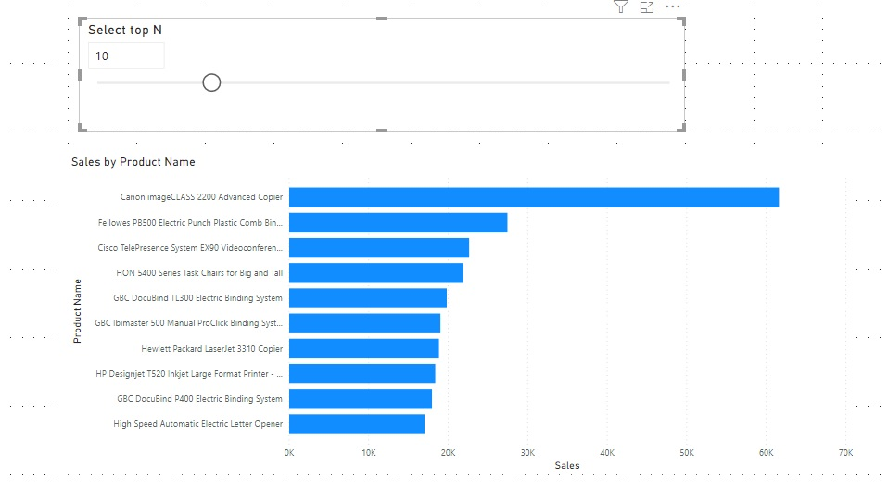
Challenge - 04
Instructions –
Data Set – SuperStore
Create a parameter called Top N
Create a bar chart to rank the top selling Product Names by sales
Rank them in descending order
The dynamic Top N parameter should filter the visualization dynamically, whether I toggle between Top 1 to 30
Desired Report
Visual Analytics with Power BI
Notes:
rank = RANKX(ALL(Orders[Product Name]), CALCULATE(sum(Orders[Sales])))
flag = IF([rank]>'Top N'[Parameter Value], 0, 1)

Slide 8
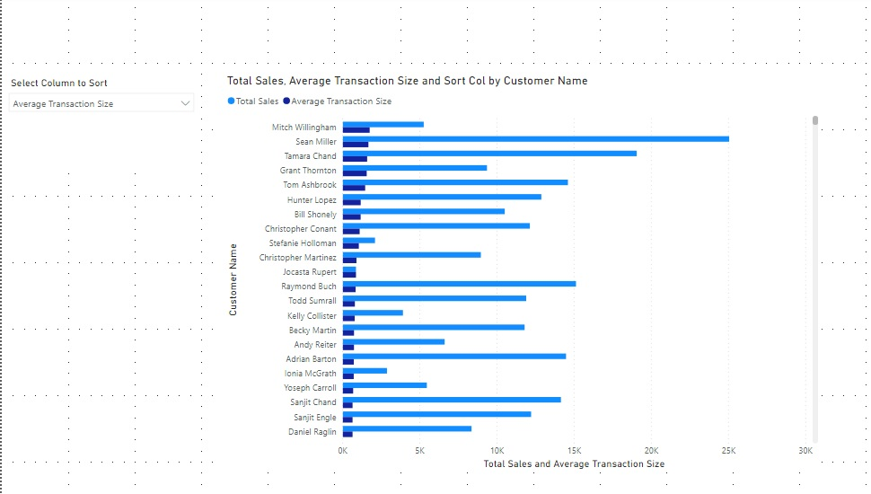
Challenge - 05
Instructions –
Data Set – SuperStore
Create 2 measures (Total Sales and Average Transaction Size per Order)
Create a parameter so I can dynamically sort in descending order the customers based on either of the 2 measures (the screenshots shows that average transaction size is selected and so report is sorted by Average Transaction Size)
Desired Report
Visual Analytics with Power BI
Notes:
Sort_table= {("Total sales"),("Average Transaction Size")}
avg_trans_size = SUM(Orders[Sales])/COUNT(Orders[Sales])
sort_col = IF(SELECTEDVALUE(Sort_table[Sort by]) = "Average Transaction Size", [avg_trans_size], Orders[total_sales])

Slide 9
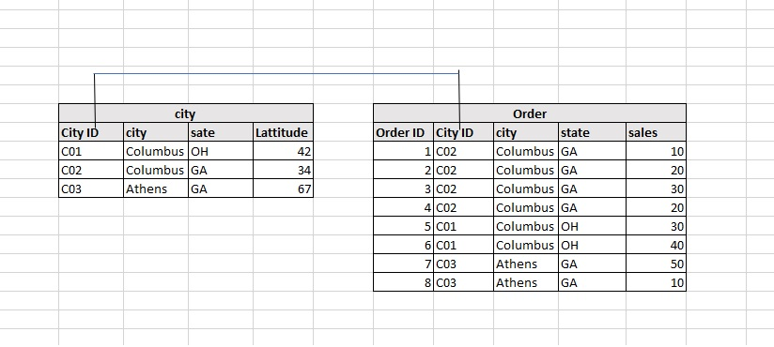
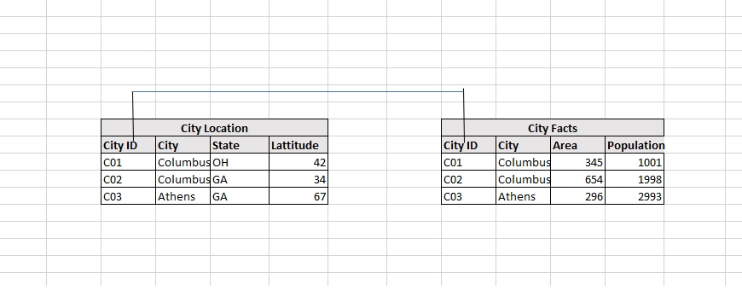
Model, Relations, Cardinality
One to One (1:1)
One to Many (1:*)
Many to One (*:1)
Visual Analytics with Power BI

Slide 10
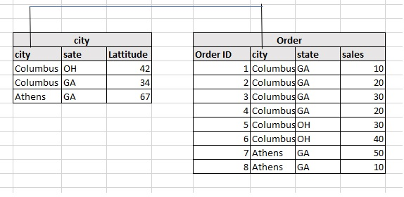
Model, Relations, Cardinality
Many to Many (*:*)
Warning:
Total sales by city
Solution – Try converting it to one to many.
Visual Analytics with Power BI

Slide 11
Challenge - 06
Instructions –
Data Set – Restaurant Chain (Application Generated Messy Data)
Build a dashboard to understand various trends and insights (use "Indic Sales" as Sales; use "# Trans" as Traffic)
Provide Sales and Traffic summary for regions and drill down options to explore Locations and store
Provide a monthly summary of sales and traffic for each store
Provide a week over week Traffic trend chart and dropdown filter for Region
Provide Sales and Traffic summary for regions and drill down options to explore Locations and store
Provide a 7 Days (Monday to Sunday) Traffic Analysis for Ontario Stores
Identify the top 3 restaurants that sold the most Jarritos as a percentage of their restaurant sales during this period (use "Total Mtn" as Menu Item Daily Sales; "use "Indic Sales" as Sales)
How many Jarritos by traffic were sold for the top 3 restaurants? (use "# Trans" as Traffic)
Visual Analytics with Power BI

